Slide 1

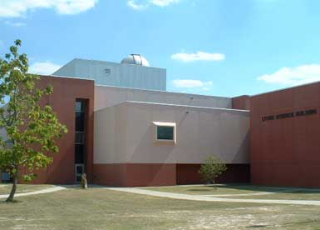

The mission of Research and Technology Transfer Office is to: --- Promote collaborative research priorities and themes indicated by the Chancellor and the VCAA/Provost for the future of the University, --- Promote and encourage investment in research infrastructure, interdisciplinary research, and oversight technology transfer activities, --- Formulate and promote innovative activities, set the research and services guidelines, in order to generate interdisciplinary collaborative partnership among various units at FSU, and in partnership with State, Federal and private agencies.
What’s New?
Research and Technology Transfer Office at Fayetteville State University promotes collaboration, innovation, technology transfer, partnership, and supports economics development
Contact Us:
Research and Technology Transfer
Fayetteville State University
1200 Murchison Road
Fayetteville, NC 28301-15475, USA
Phone: 910-672-2640
Fax: 910-672-2110
Lyons Science Building
Dr. Daryush ILA
Associate Vice Chancellor
For Research and Technology Transfer
Ms. Amy Mendez
Admin Associate, LS122

Slide 2

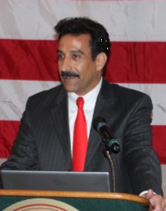
Welcome All,
With a growing campus located eight miles from Fort Bragg, the largest military base in the U.S., and one hour south of North Carolina’s Research Triangle, the largest research park in the U.S., Fayetteville State University is in a prime location geographically to become one of the leading educational research institutions of the southeastern United States. FSU is capitalizing on every opportunity presented by its physical proximity to these entities by partnering with individuals and administrations that recognize and respect FSU’s dedicated, innovative and internationally esteemed faculty. These affiliations are not only providing an outlet for the research endeavors of our faculty and staff, they are providing a conduit through which the expertise of these outside entities can influence and enhance research and instruction at FSU.
FSU has a highly diverse student population, yet it proudly retains its status as an HBCU that has provided research-based educational opportunities to underrepresented groups for almost 150 years. In the past few decades, many of those educational opportunities were the product of funding from private foundations as well as local, state, and federal government agencies. The Research Office and the Office of Sponsored Research and Programs takes great pride in providing FSU faculty and staff the assistance and guidance they need to unlock new sources of funding that in turn unlock new possibilities for educational research and programming.
On behalf of the Research and Technology Transfer Office, and the Office of Sponsored Research and Programs, I would like to thank Chancellor James Anderson and Provost Jon Young for their support. I would also like to thank the faculty and staff who have worked tirelessly to create proposals that capture their dreams and visions, and for allowing our staff to assist in bringing those dreams and visions to fruition. We invite you to visit our webpage at www.uncfsu.edu/research to learn more about the university’s research and sponsored projects, and the staff that supports these efforts.
Dr. Daryush ILA, Associate Vice Chancellor for Research,
Technology Transfer Officer and Professor of Chemistry and Physics

